Slide 1
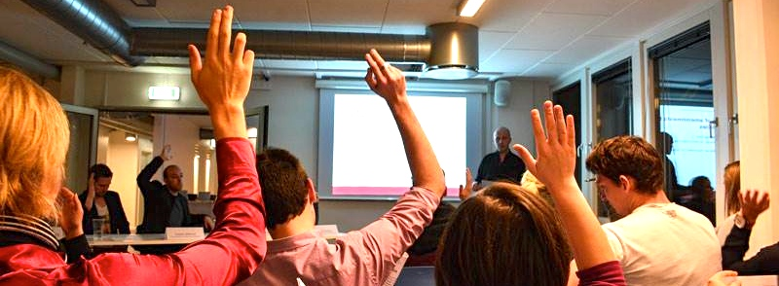
Welcome to
Cphbusiness Students
12.04.2016

Slide 2
AGENDA
Election of moderator
Election of referent
The boards’ report
Budget and financial reporting
Auditors’ observations of the accounts
Approval of financial statements
Approval of amendments to the formalities
Election of board members and alternates
Election of auditor(s)
Member topics
Optional

Slide 3
1.
Election of moderator

Slide 4
2.
Election of referent

Slide 5
3. The boards’ report
New slogan – ’Better Together’
New President and Vice president in February 2015.
The President resigned due to personal issues.
The Vice president resigned due to personal issues.
Lack of team work between the P and VP.
New Chairman was elected in August 2015.
New departments.
Culture -> Bars and Events.
No more cash at Friday bars.
New volunteers - Bye to old volunteers.
Charlotte – The Cphbusiness employee star.

Slide 6
4. Budget and financial reporting
Income | 2016/2017
iZettle, Friday bar income | 180.000
Monso, Friday bar income | 85.000
Ticket sale | 130.000
Contribution, Cphbusiness | 200.000
Sponsorships | 125.000
Income in Total | 720.000

Slide 7
Expenses | 2016/2017
E-conomics | 4.000
Fees, iZettle and Monso | 10.000
Meetings | 21.000
Studenterbolaget | 270.000
Loan, Cphbusiness | 20.000
Events | 350.000
Promotion | 25.000
Expenses in total | 700.000

Slide 8
4. Budget and financial reporting
Budget for 2016/2017 will be laid for approval of the board in May 2016.
Result | 2016/2017
Income in total | 720.000
Expenses in total | 700.000
Result in total | 20.000

Slide 9
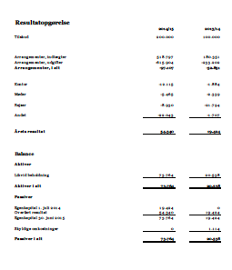
4. Budget and financial reporting
The annual report: 1 July 2014 - 30 June 2015
Accountant: Carsten Blicher, PricewaterhouseCoopers

Slide 10
Income statement | 2014/2015 | 2013/2014
Contribution from Cphbusiness | 200.000 | 100.000
Events, income | 518.797 | 180.351
Events, expenses | - 615.904 | - 233.202
Events in total | - 97.107 | - 52.851
Office | - 12.115 | - 1.884
Meetings | - 5.465 | - 2.339
Transportation | - 8.930 | - 21.794
Other | - 22.043 | - 1.707
Annual result | 54.340 | 19.424

Slide 11
Balance |  | 2014/2015 | 2013/2014
Assets
Liquid assets |  | 73.764 | 20.538
Assets in total |  | 73.764 | 20.538
Liability
Equity 1 July 2014 |  | 19.424 | 0
Retained earnings |  | 54.340 | 19.424
Equity 30 June 2015 |  | 73.764 | 19.424
Accounts payable |  | 0 | 1.114
Liability in total |  | 73.764 | 20.538

Slide 12
5. Auditors’ observations of the accounts
“The accounts must be to be more on top of things.
The accounts for 2014/15 show the income and expenses roughly, but the allocation of the expenses is partly estimated.
The Danish Bookkeeping Act is not fulfilled. There is no documentation for what the receipts relate to and there is a lack of receipts. Nor is there a proper bookkeeping.”
Carsten Blicher
State authorized public accountant
PricewaterhouseCoopers

Slide 13
5. Auditors’ observations of the accounts
Actions and initiatives:
Financial advisor (Filip Lange, Ressource manager from København Nord) helps the student organisation with establishing rules, workflow and bookkeeping procedures.
Together with the financial advisor the Finance department hosts Finance Workshops for the management group.

Slide 14
6.
Approval of
financial statements?

Slide 15
7. Approval of amendments to the formalities
Addition to § 4. Subsection 3.
(…) The moderator, the board members, the staff at Cphbusiness as well as the students at Cphbusiness have the right to speak at the AGM. (…)
Approval?

Slide 16
7. Approval of amendments to the formalities
Suggestion: § 4. Subsection 6.
Delete the numbers in point 7 on the agenda:
7. Election of 7 board members and 2 alternates
Approval?

Slide 17
7. Approval of amendments to the formalities
G
A
B
Current challenge:
A gab between the board and the daily management.
The board has no knowledge and insight in the daily tasks and challenges of the student organisation.

Slide 18
7. Approval of amendments to the formalities
Suggestion:
If Active Members with experience and relevant skills form the board →
Fully awareness of financial situation
Fully awareness of daily needs and challenges
Can easily implement the strategy

Slide 19
7. Approval of amendments to the formalities
Suggestion:
Create an Advisory Board:
Input and sparring with the business life
Members:
External members from the business life
Representatives from the board of directors
Next step:
The board defines form and structure of the Advisory Board
The board finds and invites external members

Slide 20
7. Approval of amendments to the formalities
Suggestion: § 4. Subsection 10.
“The board consists of 9 students elected at the AGM, 5 substitutes elected at the AGM as well as 2 employees appointed by the president of Cphbusiness.
The student representatives and the substitutes should be elected among the active members in the student organisation and should be based on experience within the student organisation and relevant skills. If possible, the substitutes should be 1st or 2nd semester students.
(…) and networking interests of the students.”
Approval?

Slide 21
7. Approval of amendments to the formalities
§4. Subsection 11. Delete Subsection 11.
(about the daily management)
§ 5. Subsection 2. (…) This can be in the form of a network, study councils, organisation or activity committees - the form is determined by the organisation's board of directors. (…)
§ 6. Businesses and activities. Delete §6.
Approval?

Slide 22
7. Approval of amendments to the formalities
§ 7. Subscription right (will become §6 if §6 is deleted)
“The chairman of the board, the vice chairman and the treasurer signs the organisation and can act individually.
Power of procuration can be granted.”
Approval?

Slide 23
7. Approval of amendments to the formalities
§ 8. Economy (will become §7 if §6 is deleted)
Subsection 1. “The financial year runs from 01.07 to 30.06”
Subsection 4. “(…) The chairman, the vice chairman and the treasurer establish and manage the organisation’s account. They should not strive towards establishing a fortune, unless the fortune is established to achieve a specific purpose.”
Approval?

Slide 24
7. Approval of amendments to the formalities
Addition to § 8. Economy: (will become §7 if §6 is deleted)
Subsection 5. The organisation is only liable for its obligations with the organisation at any time belonging fortune. The members of the organisation or the board of directors have no personal liability.
Approval?

Slide 25
7. Approval of amendments to the formalities
§ 9. Dissolution (will become §8 if §6 is deleted)
§ 10. Changes to the statutes (will become §9 if §6 is deleted)
§11. Entry into force (will become §10 if §6 is deleted)
Approval?

Slide 26
8. Election of
board members and alternates
Candidates for board members (9):
Helene Borgstrøm. Helene is an active member in the student organisation’s Communication department.
Bartlomiej Gozdek. Bartlomiej is an active member in the student organisation’s Bar department.
Sebastian Holmegaard. Sebastian is an active member in the student organisation and is Head of the Business department.
Barbora Kochlicova. Barbora is an active member in the student organisation’s HR department.
Tanja Green Olander. Tanja is an active member in the student organisation and is the secretary.
Lujza Grossmanová. Lujza is an active member in the student organisation and is Head of the Finance department.
Let’s vote!

Slide 27
8. Election of
board members and alternates
Candidates for alternates (5):
Luca Adriano Dalessandro. Luca is an active member in the student organisation’s Business department.
Maria Agerlin Blicher. Maria is an active member in the student organisation’s Bar department.
Gabriella Ploug. Gabriella is an active member in the student organisation’s Communication department.
Sebastian Pilgaard Laursen. Sebastian is an active member in the student organisation’s Finance department.
Let’s vote!

Slide 28
8. Election of
board members and alternates
Let’s collect the voting paper

Slide 29
8. Election of
board members and alternates
6 Candidates for board members (9)
4 Candidates for alternates (5)
We need 4 more board members
Suggestion:
”The new board members and alternates find and elect the lasts board members and alternates.”
Approval?

Slide 30
9. Election of auditor(s)
Suggestion:
Continue with the present accountant
Approval?

Slide 31
10.
Member topics

Slide 32
11.
Optional

Slide 33
Keep up to date about
the student organisation

