Slide 1
22nd Board meeting
8 March 2017
- Better together -

Slide 2
Agenda
Approval of the agenda
Approval of the minutes from the last meeting
Board members
Advisory Board meeting
Strategy draft
Active Members Day
Financial situation
Status – HR
Status – Event
Status – Communication
Other topics
Next meeting
- Better together -

Slide 3
1. Approval of agenda?

Slide 4
2. Approval of minutes
from the last meeting
The minutes from the 20nd and the 21st meeting have not been sent out.

Slide 5
3. Board members
/Charlotte
Candidates for the board:
Kim Clement – chairman position
Vilhelmine Ozolina
Frederik Ladehoff
Vote board member off:
Nickole Gade

Slide 6
4. Advisory Board meeting /Charlotte and Advisory Board
The summary from the 1st Advisory Board meeting is on its way
No consistency
Vulnerable to changes
Chain of command
Ambitious beyond capability
Structure
Unknown brand
Many firsts → Big workload
Few do all the work
Stressful environment

Slide 7
5. Strategy draft /Charlotte
Strategy content:
Ambition and purpose with the strategy
The scope of the student organisation:
Activity plan
Resource allocation
Task allocation
Activity manuals
Meeting frequency
Recruitment of volunteers
Volunteer motivation

Slide 8
5. Strategy: Ambition and purpose
To create a focused effort that creates value for:
the volunteers
the students at Cphbusiness
Cphbusiness as an institution
volunteers
Cphbusiness
students

Slide 9
5. Strategy: Ambition and purpose
Goal is to handle:
Social activities, targeted to all students at Cphbusiness
Professional activities that contribute with new knowledge to the students at Cphbusiness
Student political tasks internally at Cphbusiness and nationally e.g. SU, LMS etc.
Goal: The student organisation should be an attractive organisation to be a part of.

Slide 10
5. Strategy: Ambition and purpose
To do this we need a clear scope of:
The student organisation’s tasks
The extent of each task
The expectations to each volunteer
Each volunteer should be able to:
Work with well-defined and clear tasks
Develop their skills without being too stressed

Slide 11
5. Strategy
It’s time to draw!

Slide 12
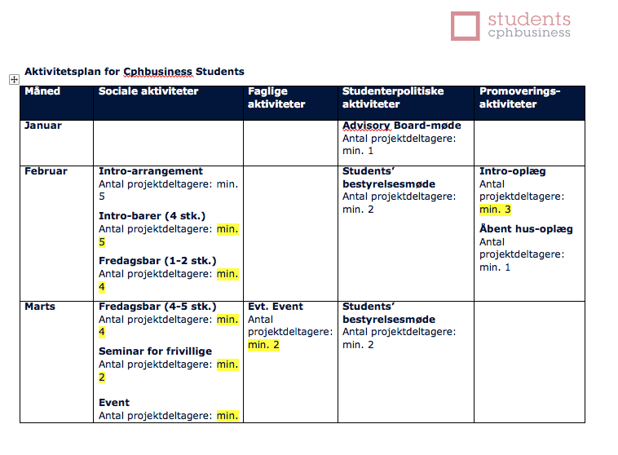
5. Strategy draft /Charlotte
Activity plan:

Slide 13
5. Strategy: Motivation
Benefits:
Good social environment
Broaden network
Skills development
Relevant business experience for the resume
Credits:
Diploma
Recommendation
Honours on graduation diploma

Slide 14
5. Strategy
Feedback?
Vote:
Approval for continue the work

Slide 15
5. Strategy: Next step
Continue the strategy work
Detailed workflow
Activity manuals
Work group:
Who?

Slide 16
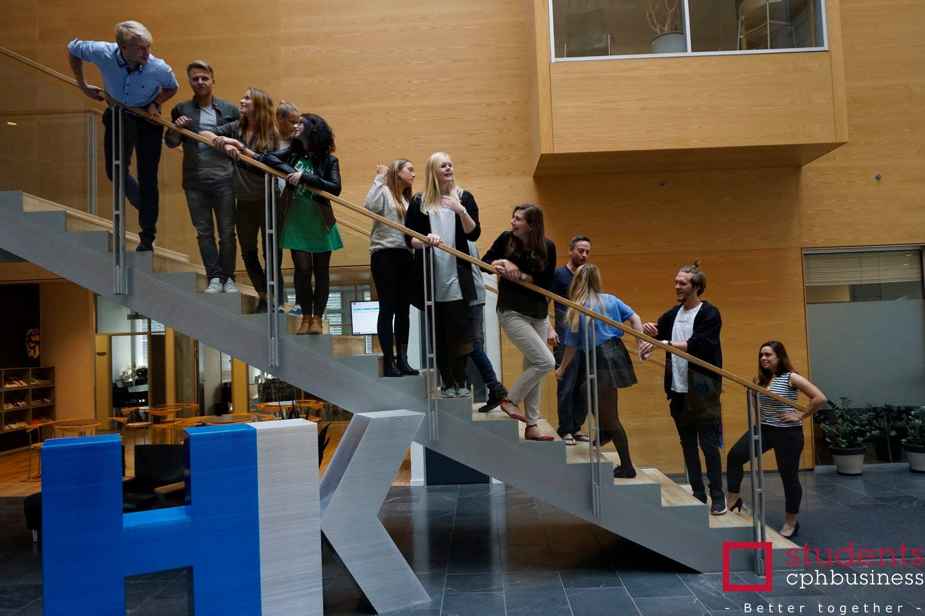
6. Active Members Day /Charlotte
Wednesday 29 March 2017
From 16:00 – 21:00
Begin at 16:30?
Where: HK, Weidekampsgade 8, 2300 Kbh S.

Slide 17
6. Active Members Day /Charlotte
Programme:
Welcome – around the table (20 min)
Strategy and structure (30 min)
Activity manuals (15 or 45 min)
Dinner (30 min)
Course - topic?? (60 min)
Trello course (45 min)
Visual identity (15 min)
Evaluation and goodbye (15 min)

Slide 18
7. Financial situation /Finance
Balance: + 53.019,31 DKK
The 50.000 DKK grant from Cphbusiness has been given.
All budgets looks fine
Next step: Let Finance know when the different expenses should be paid

Slide 19
8. Status /HR
Martina: Applicant for Vice president
Alternative: Thomas will return from Cambridge next semester and would like to continue as Vice president
No applicants for secretary position

Slide 20
9. Status /Event
Semester party
Budget
Other events

Slide 21
10. Status /Communication
10 active members, 2 on hold
New structure: Project based

Slide 22
10. Status /Communication
Current projects:
Semester party
Movie Night
Roskilde Festival
Friday bar
HR

Slide 23
10. Status /Communication
Other:
Social media managers
Photo bank
New design manual
Knowledge pool
Web

Slide 24
10. Status /Communication
Issues at hand:
The plan for Social media – who, when and how? What can be scheduled?
Information sharing and management online – Trello, Drive, Office? Various platforms
Implementing and working with new structure
Event promotion – dividing tasks between Events and Communication
Weekly meetings?

Slide 25
11. Other topics
Culture and vision / Viktoria
Storage for assets / Sebastian H
Study start package evaluation / Charlotte

Slide 26
12. Next meetings
23rd board meeting:
Wednesday 5 April, 17:00 – 19:00 at Cphbusiness Søerne
24th board meeting:
Wednesday 3 May, 17:00 – 19:00 at Cphbusiness Søerne
- Better together -

