Slide 1
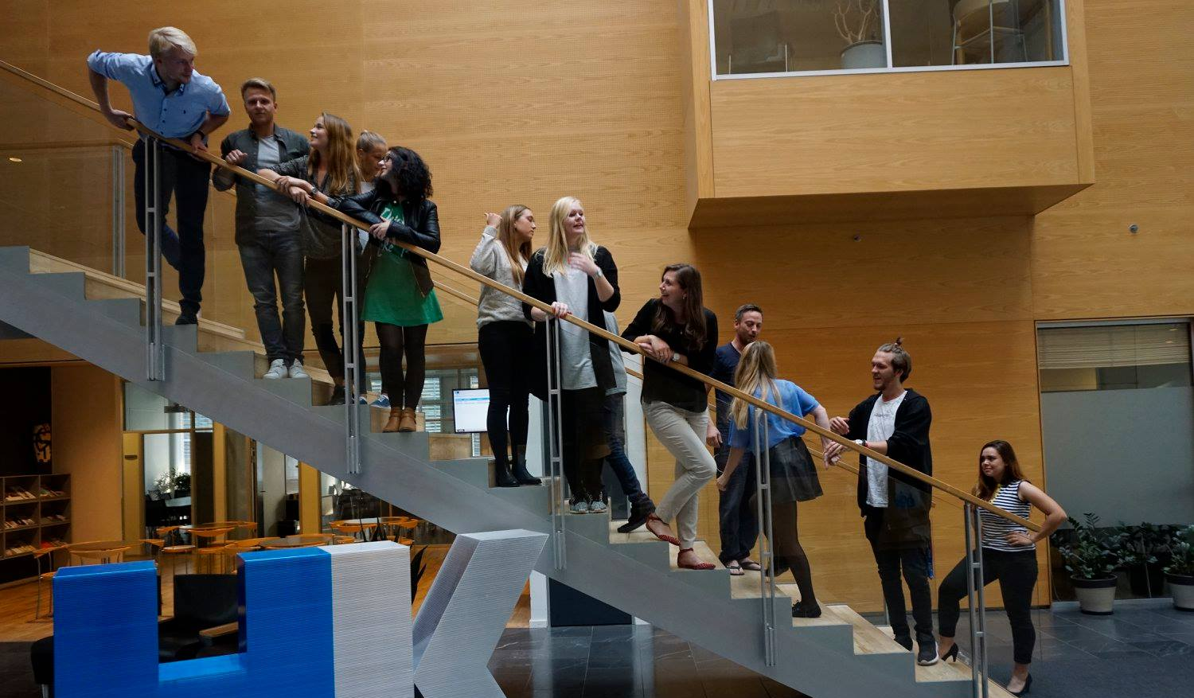
29th Board meeting
Cphbusiness Students
15.01.2019

Slide 2
Agenda
Approval of the agenda
Choice of minutes taker
Approval of the minutes (28th meeting)
Orientation from the former chairmanship
Financial orientation
Status on activities Introbars – Fridaybars – Morning Welcome Event
Constitution of the board
Other topics
Next meeting

Slide 3
1. Approval of the agenda

Slide 4
2. Choice of minutes taker

Slide 5
3. Approval of the minutes from the 28th board meeting

Slide 6
4. Orientation from Anine & Samuel

Slide 7
5. Financial orientation v/Kimie
Current balance: 135.184,84 DKK
All invoices for last semester has been paid.
Isabella and Emilie are working on the budget for October-December.

Slide 8
6. Status on activities
Introbar planned: City: 29. January 14 - 20 Søerne: 1st February 14 - 20 Lyngby: 1st February 14 - 20 Nørrebro: 8th February 14 - 18
Fridaybars planned for both Søerne and City (?) Morning Welcome Event Lyngby: 28 January 08 – 09.30 (Coffee and goodiebags with Cphbusiness, Students- and HK-’stuf’) Nørrebro: 4th February 08.30 – 09.30 (Goodiebags with Cphbusiness, Students- and HK-’stuf’)

Slide 9
7. Constitution of the board
Cphbusiness Students Annual General Meeting was held November 15, 2018.
5 students were elected as ordinary board members 3 students were elected as alternates.
The election period is January 1th 2019 – December 31 2019

Slide 10
7. Constitution of the board
Ordinary members
Christoffer Lundberg
Emilie Holmbom Knudsen
Isabella Vesterskov Lehim
Malou-Cheanne Ananiassen
Daniel Mészáros
Alternates
1th alternate: Alexander Schibbye Vildenfeldt
2nd alternate: Bianca Polec
3nd alternate: Mie Louise Nielsen

Slide 11
7. Constitution of the board
According to Articles of Organization (statutes) §5 “The board must determine its own rules of procedure and constitutes itself with a chairman, a vice chairman, a treasurer and a secretary.”
Roles in the board: A: Candidate(s) for chairman: B: Candidate(s) for vice chairman: C: Candidate(s) for treasurer: D: Candidate(s) for secretary

Slide 12
8. Other topics?
Include the boys from city for the introbars and the further fridaybars

Slide 13
8. Next Board meeting

