Slide 1
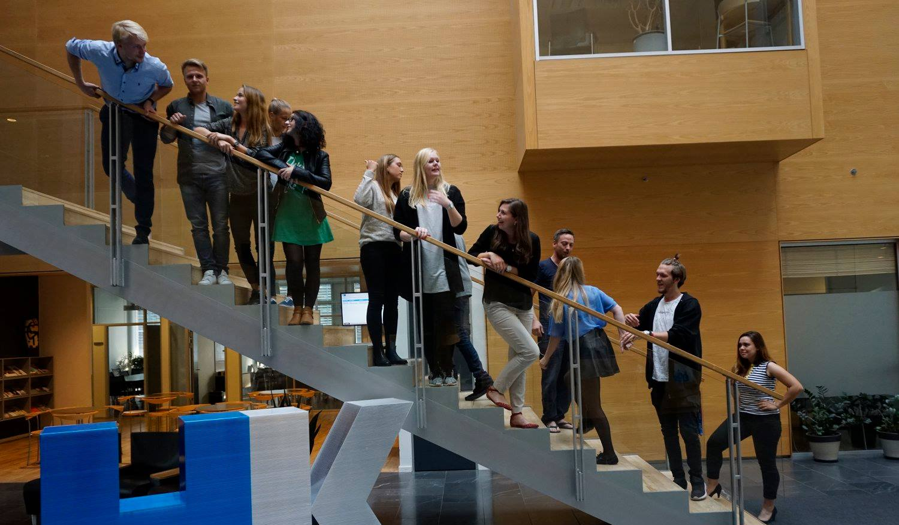
40th Board meeting
Cphbusiness Students
23.04.2020

Slide 2
Agenda
Approval of the agenda
Choice of minutes taker
Approval of the minutes (39th meeting)
Orientation by the chairman
Financial situation / Treasurer
Budget 2020/2021
Other topics
Next meeting: 28 September

Slide 3
1. Approval of the agenda

Slide 4
2. Choice of minutes taker

Slide 5
3. Approval of the minutes from the 39th board meeting

Slide 6
4. Orientation
Status on manager roles
Strategy weekend

Slide 7
5. Financial situation

Slide 8
6. Budget 2019/2020
Updated budget fall 2021

Slide 9
7. Other topics
Welcome bags for new students (Mille)
Online activities (Charlotte)
SoMe activities (Charlotte)

Slide 10
8. Next Board meeting
28 september

Slide 11
10. Other topics

