Slide 1
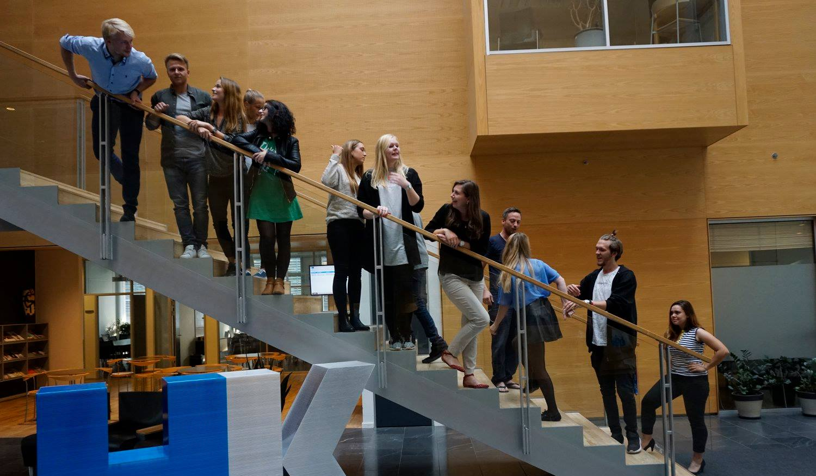
42nd Board meeting
Cphbusiness Students
19.11.2020

Slide 2
Agenda
Approval of the agenda
Choice of minutes taker
Approval of the minutes (41st meeting)
New board
Orientation by the chairman
Financial situation / Treasurer
Activity wheel and budget 2021
Other topics
Next meeting

Slide 3
1. Approval of the agenda

Slide 4
2. Choice of minutes taker

Slide 5
3. Approval of the minutes from the last board meeting

Slide 6
4. New board
Welcome
Introduction to:
Ordinary members (5) and alternates (3)
The board’s guidelines
The roles in the board:
Chairman
Vice chairman
Treasurer
Secretary

Slide 7
4. Orientation
The board’s tasks and responsibilities:
The board works with the strategy and the daily tasks of the organisation.
The board meets 4 times a year unless the board deems it necessary to meet more frequently.
The board is competent when at least 4 board members attend the board meetings. In case of less than 4 board members attending, absent board members may give their vote on topics in writing in advance of the meeting.
Two student representatives in the academy’s board of directors

Slide 8
4. New board
Next step:
Get to know each other
Meeting for the new board. Purpose with the meeting:
The board constitutes itself with a chairman, a vice chairman, a treasurer and a secretary. The chairman must be elected from among the students.
The board must choose two student representatives for the academy’s board of directors.
Date suggestion: xx December
Board meetings in 2021 – date suggestions:
Xx January, xx April, xx September, xx November

Slide 9
5. Orientation by the chairmanship
Status on activities in the student organisation
Status on volunteers:
Now
Next semester
Status on vacant positions
Diplomas for volunteers leaving the student organisation
Semester celebration for the volunteers

Slide 10
6. Financial situation
Status on the auditor
Status on the financial report 01/07-2019 to 30/06-2020
Status on bank access
Who has access to the bank account

Slide 11
7. Activity wheel and budget 2021

Slide 12
8. Other topics
Information: Meeting with HK by Anna
Suggestion: Use Microsoft Teams as the student organisation’s platform by Charlotte
Information: Development of the student involvement at Cphbusiness by Charlotte

Slide 13
9. Next Board meeting
xx. January 2021

